Slide 1

Introduction to Deep Learning
Final Project: Bag of Words Meets Bags of Popcorn

Slide 2
Agenda
Problem Description
Machine Learning Approach used in Project
Results Analysis

Slide 3

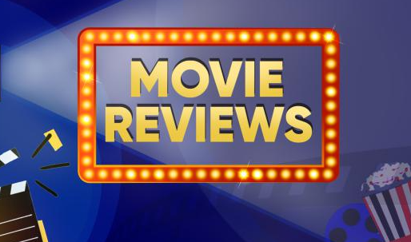

Problem Description
SENTIMENT ANALYSIS
Some other sentiment analysis applications:
Social Media
Surveys
Brand Monitoring
NEGATIVE
POSITIVE

Slide 4
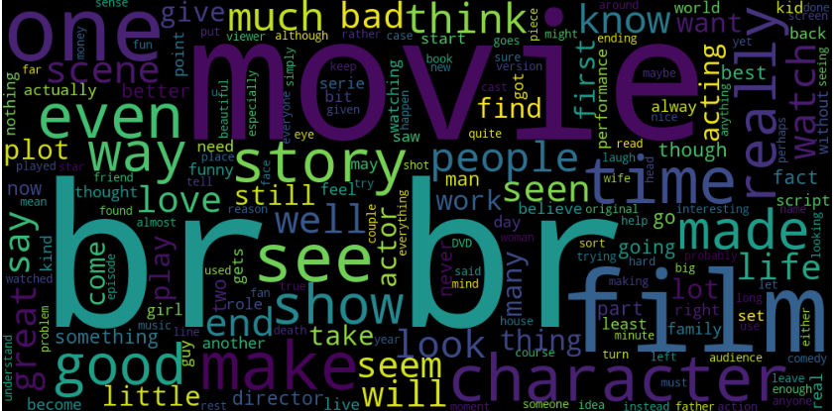
Dataset Used
25, 000 reviews from IMDB
File with 3 columns : “Id” , “Sentiment Label”, “Review”
Training dataset has equal distribution of positive and negative reviews ( 12,500 ítems each)
Example of a movie review from dataset:
"I dont know why people think this is such a bad movie. Its got a pretty good plot, some good action, and the change of location for Harry does not hurt either. Sure some of its offensive and gratuitous but this is not the only movie like that. Eastwood is in good form as Dirty Harry, and I liked Pat Hingle in this movie as the small town cop. If you liked DIRTY HARRY, then you should see this one, its a lot better than THE DEAD POOL. 4/5“

Slide 5
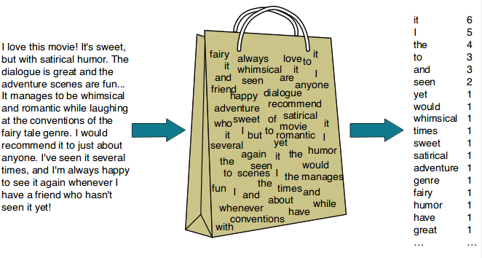
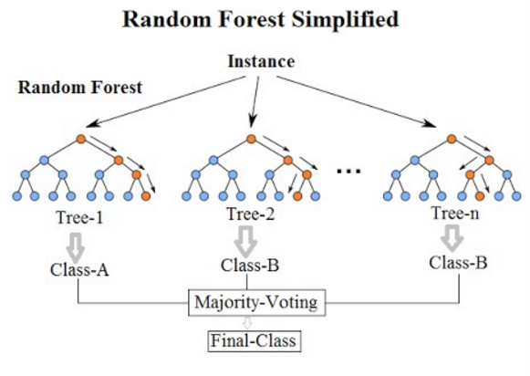
Machine Learning Approach

Slide 6
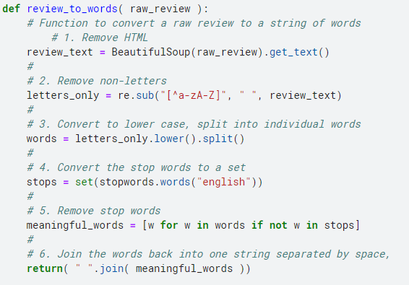
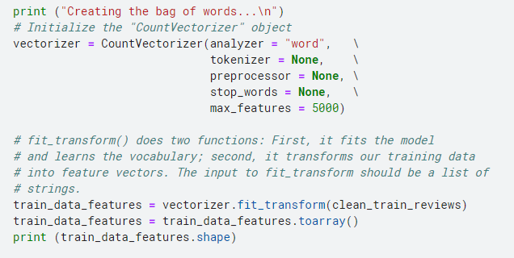
Code’s General Overview
Data Cleaning
Bag of Words Creation

Slide 7
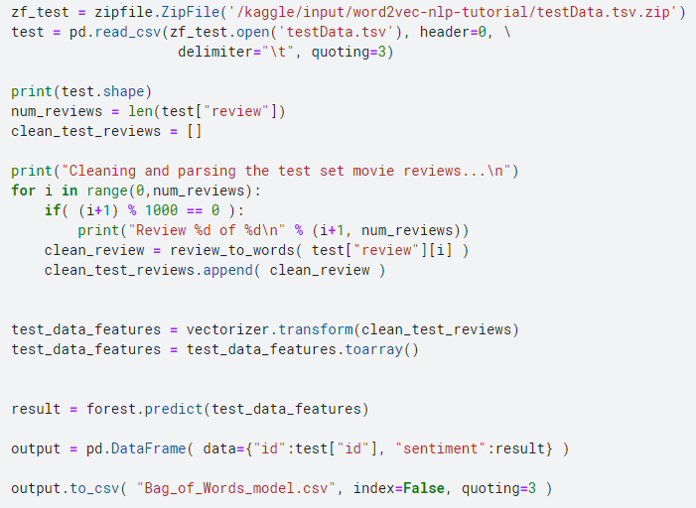
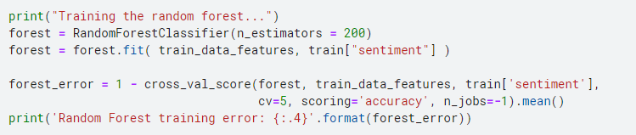
Code’s General Overview
Generating Predictions
Training
Training Error: 0.151

Slide 8
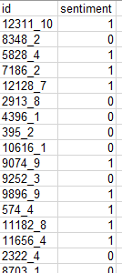
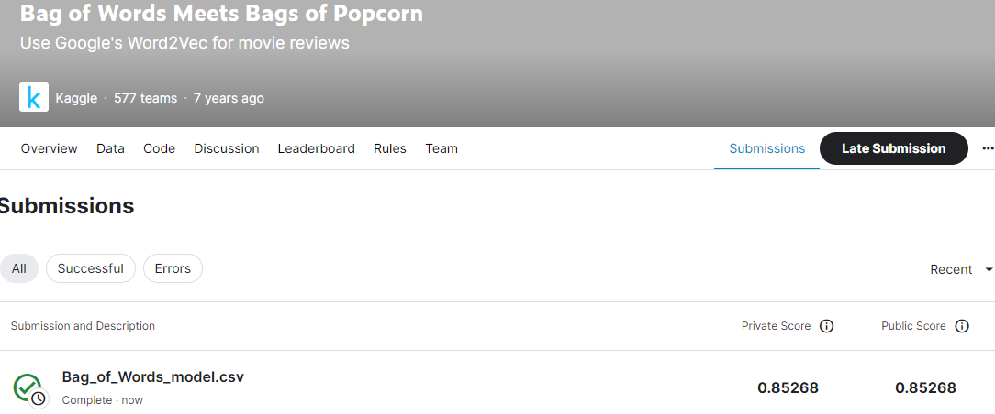
Result Analysis
Ways to Improve Model:
Use different number of vocabulary words
Apply a different classifier
Include a stemming process

Slide 9
References
Bag of Words Meets Bags of Popcorn. Kaggle. https://www.kaggle.com/competitions/word2vec-nlp-tutorial/overview/part-1-for-beginners-bag-of-words
Bag of Words Model. Wikipedia. https://en.wikipedia.org/wiki/Bag-of-words_model
Bag of Words Meets Bag of Popcorn. Github. https://github.com/ParveshDhawan/Bag-of-Words-Meets-Bags-of-Popcorn/blob/master/solution.ipynb
Beatiful Soup Documentation. Crummy. https://www.crummy.com/software/BeautifulSoup/bs4/doc/
All pictures used from in slides 3 and 5 were taken from Internet for illustration purposes only.

